Slide 1
2 rabbits give girth to 2 rabbits
These 2 rabbits grow up to give birth to 2 rabbits each.
They each give birth to 2 rabbits each
who also grow up to give birth to 2 rabbits each
And so do the next generation
And the next.
How many rabbits will be born in generation that is born next?
2 rabbits x 2 rabbits x 2 rabbits x 2 rabbits x 2 rabbits x 2 rabbits x 2 rabbits x 2 rabbits =
2 x 2 x 2 x 2 x 2 x 2 x 2 x 2 = 256 rabbits
So after 8 generations there is 256 rabbits born in the last generation.
Now write down the calculation for 15 generations.
2 x 2 x 2 x 2 x 2 x 2 x 2 x 2 x 2 x 2 x 2 x 2 x 2 x 2 x 2 = 32,768
Now write it down for 25 generations.
2 x 2 x 2 x 2 x 2 x 2 x 2 x 2 x 2 x 2 x 2 x 2 x 2 x 2 x 2 x 2 x 2 x 2 x 2 x 2 x 2 x 2 x 2 x 2 x 2 = 33,554,432
Can you think of an easier way to write this?
Can you think of an easier way to write this?

Slide 2
What are the indicies?
Indicies are a shortcut way of writing a lot of the same numbers getting multiplied together.
Why do you think we use the index laws?
1. It easier to see how many numbers we are working with.
2 x 2 x 2 x 2 x 2 x 2 x 2 x 2 x 2 x 2 x 2 x 2 x 2 x 2 x 2 x 2 x 2 x 2 x 2 x 2 x 2 x 2 x 2 x 2 x 2 vs 2 x 2 x 2 x 2 x 2 x 2 x 2 x 2 x 2 x 2 x 2 x 2 x 2 x 2 x 2 x 2 x 2 x 2 x 2 x 2 x 2 x 2 x 2 x 2 x 2 – which on is bigger?
Or 2²⁵ vs 2²⁶
2. We are less likely to make a mistake (it’s so easy to lose a “2” when you are trying to write them all out over and over again).
3. We’re lazy – who wants to write that many multiply signs and the same number over and over again.
4. Finally It’s actually easier once you get used to it.
So we are actually learning “The Index Laws” so you don’t have to write as much and can do maths with less effort.
You’re Welcome

Slide 3
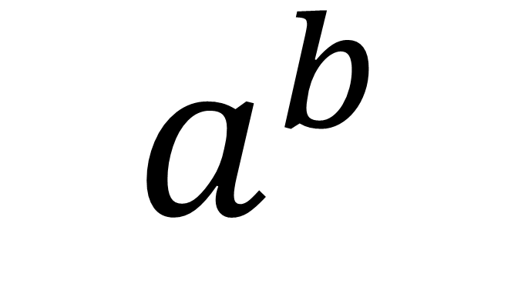
index
$$a^{b}$$
base
In order to use the index laws, the bases must be the same.

Slide 4
Index law 1
7 x 7 x 7 x 7 x 7 x 7 = 7⁶
It could also be written as
(7 x 7 x 7) x (7 x 7 x 7) = 7³ x 7³
or
(7 x 7) x (7 x 7) x (7 x 7) = 7² x 7² x 7²
So 7² x 7² x 7² = 7³ x 7³ = 7⁶
Index law 1 is that when the same bases are multiplied together we simply add all the indicies together.
7² x 7² x 7² = 7²⁺²⁺² = 7⁶
When a number and a letter are both involved we deal with them separately.
2a² x 3a⁴ = 2 x (a x a) x 3 x (a x a x a x a) = 6a⁶

Slide 5
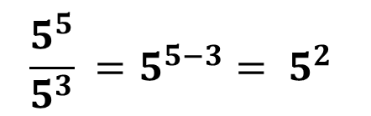
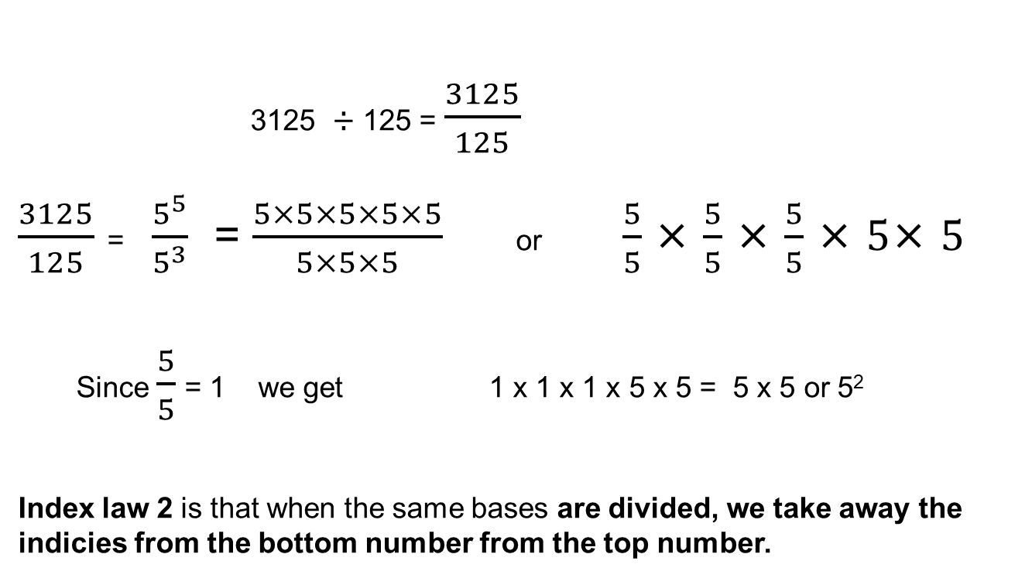
Index law 2
3125 ÷ 125 = $\frac{3125}{125}$
$\frac{3125}{125}$ = $\frac{5^{5}}{5^{3}}$ = $\frac{5×5×5×5×5}{5×5×5}$ or $\frac{5}{5}$ × $\frac{5}{5}$ × $\frac{5}{5}$ × $5$× $5$
Since $\frac{5}{5}$ = 1 we get 1 x 1 x 1 x 5 x 5 = 5 x 5 or 5²
Index law 2 is that when the same bases are divided, we take away the indicies from the bottom number from the top number.
Since 3125 = 5⁵ and 125 = 5³
$$\frac{5^{5}}{5^{3}} =5^{5−3}= 5^{2}$$
8a⁵ = 8(a x a x a x a x a) = 4a³
2a² 2(a x a)

Slide 6


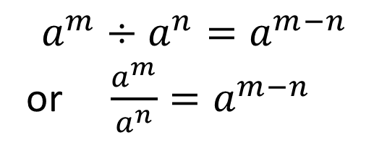

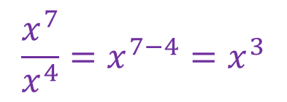

24
7
30
Date
Index Laws
EQ – Describe how the index laws can be used to simplify expressions with indices.
index
$$a^{b}$$
base
What are the index laws?
Index Law 1
Example
Index Law 2
5

Slide 7

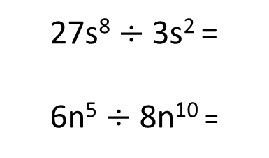
Lets try a few together
2⁷ x 2⁵ =
9⁵ x 9³ =
a⁷ x a⁻³ =
b⁻⁸ x b⁴ =
9⁵ $÷$ 9³ =
a⁷ $÷$ a⁻³ =
2a³ x 7a⁴ =
3s⁸ x 9s² =
6n⁵ x 8n¹⁰ =
7h² x -3h⁴ =
27s⁸ $÷$ 3s² =
6n⁵ $÷$ 8n¹⁰ =

